Slide 1
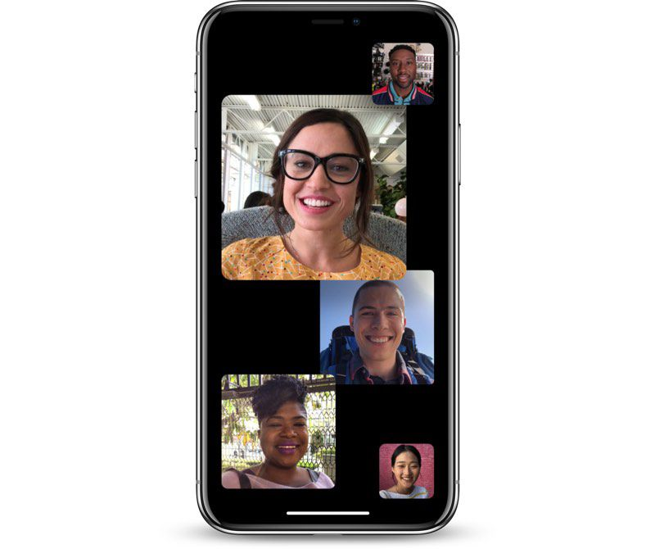
Web Conferencing at Forsyth Tech
by Patrick Burcham

Slide 2
What my Project is
I was to take an online survey from the entire student body that was to determine what they felt about web conferencing and how they would react to it being the school’s solution for advising in the future.
The survey was 10 questions long with multiple choice, one choice or the other and free response questions
Unfortunately, I wanted to get more responses from the students. I had an on campus means of reaching the students about the survey that never went live because we had to stay home every day after spring break. If this had been implemented, I might have met my goal for the sample size.

Slide 3
The Sample and Population I was working with
The sample size (subset of the population) was 57 students
The Population size (entire student body using Office 365) is 6,733, this is not the same thing as the population of the entire college, but it is close
The goal was to capture 1% of all students at the College using office 365
The sample size wasn’t quite the goal (1%), but it is close enough for statistical analysis to occur

Slide 4
Sample Students Male vs. Female

Slide 5
Sample Student’s College Statuses at Forsyth Tech

Slide 6
Sample Students Preferred Web Conferencing Software

Slide 7
Sample Students Number of Visits to Advisor Outside of Class per a Semester

Slide 8
Sample Students Preferred Notifications

Slide 9
Sample Students Perceived Difficulty of Software Tools (One is the easiest, Ten is the hardest)

Slide 10
Sample Students Meeting Preferences

Slide 11
Sample Students Agreeableness to Web Conferencing

Slide 12
Some of the Free Response Answers (What is your biggest concern about Web Conferencing)
Availability. Not able to ask questions as easily as in person.
Not nearly as personable, students will lose true communication skills.
Students who would not have access to at home internet and lack a device.
Privacy of the student's and instructor's interactions.
It can be difficult to get your point across or be noticed by the professor when you have a question.
Right now it makes sense more than ever with COVID-19. My only concerns are people feeling like classes are a choice and can easily forget when at home, bandwidth limitations, and participation. I think Teams would be a good alternative because then you can add every student in the class to chats and hopefully, if they are on their PC or phone, they get the notices about classes or updates quicker. Bb Colaborate is nice and works, but I would like to have more of a constant contact.

Slide 13
“1 to 3 Guideline” Repetition of 25 to 75

Slide 14
Take Aways from the Single Factor Data
Full Time Students with online and on campus classes make up almost half of all students at the campus
Nearly ¾ of all students visit their teachers/advisors at least 0-2 times a week
Although Blackboard is going to be pushed by the school it seems there are two contenders for the out of class solution. They are Zoom and Microsoft Teams
More than ¾ of students rank their perceived difficulty 5 and under. This shows that based on what they think they may be ready for the complexity of meeting advisors and teachers online without too many problems.

Slide 15
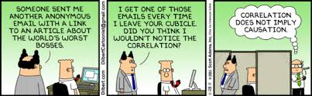
Filtering Data and Cross-Referencing Different Factors for Relationships

Slide 16
Male and Female Perceived Average Difficulty of Using Web Conferencing Tools

Slide 17
Does Being Male or Female Affect the perceived difficulty of the software?
When looking at the means of the two samples (Male and female) there is a difference. However, the question is whether or not the difference between the male mean and the female mean is larger enough to support the idea that being a specific sex actually affects your perceived difficulty. These are sample means, but that doesn’t mean we can’t do calculations based on it now.
The Null Hypothesis is that the difference between the male mean and the female mean is zero (statistically).
The Alternative Hypothesis is that the difference between the male mean and the female mean is not zero (statistically).

Slide 18
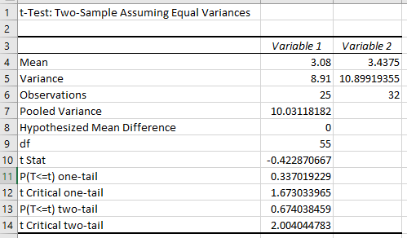
Outcome of the Calculation
The significance level is equal to .05 (or 5%). Because the P for two tail is greater than .05 then you accept the null hypothesis, which means that the difference between the means of males and females are not significantly different,
This means that there is a 95% chance that the difference between being a female or male does not affect the outcome of the perceived difficulty average.

Slide 19
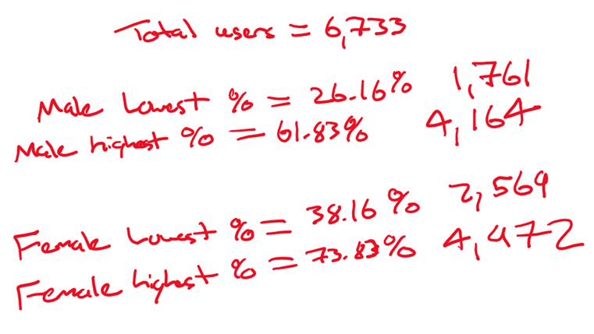
The Upper and Lower Limits of Male and Female Populations (99% Confidence Intervals)

Slide 20
Male and Female Preferred Software

Slide 21
Male and Female College Status

Slide 22
Male and Female Agreeableness to Web Conferencing

Slide 23
Male and Female Preferred Meeting Methods

Slide 24
Take Aways from the Multi Factor Data
Females preferred Zoom and Blackboard while males preferred Zoom, Blackboard and Microsoft Teams
Males have a larger percentage of neutral to strong agreeableness than females towards web conferencing being the solution for the college
Males had more varied college statuses (Full Time vs Part time and All online vs some online are all on campus) than females did
The majority of males preferred online meetings while the majority of females preferred face to face meetings

Slide 25
Meeting Preferences of Full Time Students

Slide 26
Meeting Preferences of Part Time Students

Slide 27
Take Aways from Face to Face vs Online Meetings for Students
Full Time Students with Both Online and Offline preferred meeting Face to Face
Full Time Students with On Campus Only preferred meeting face to face
Full Time Students with Online Only preferred Meeting Online
Part Time Students with On Campus Only preferred Face to Face
Part Time Students with Both Preferred Online Meetings
Part Time Students with Online only Preferred Online

Slide 28
Final Suggestions for Forsyth Tech
1. Most Importantly, decide which parts of the data is the more important. Not every single point of data needs to be looked at. Like a factorial equation, when you consider balancing more and more factors the larger the total sum of all those factors become. This makes it increasingly hard to come to a definitive final decision. This may sound counter intuitive for a Data Analyst to suggest, but sometimes, going with your most important factors is the best thing you can do. If you try to stretch yourself too thin in pleasing all demographics of the student body, you will just disappoint everyone.
2. There are other factors that need to be taken into consideration besides popularity, such as security when it comes to Web conferencing software. For example, Microsoft Teams might not have a ton of market share right now, but it’s being backed up by one of the largest companies in the world (Microsoft). It has a possibility for the out of class solution. It may pick up market share later as Microsoft pushes it.

Slide 29
Addendum

Slide 30
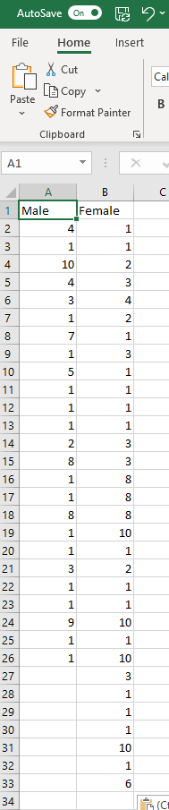
Calculating Whether or not the Perceived difference between Males and Females are roughly the same
As the number of entries get larger, the number of calculations that need to be done (especially Variances) goes up, I’ll show you how to use the Excel way of calculating the
P-Value

Slide 31
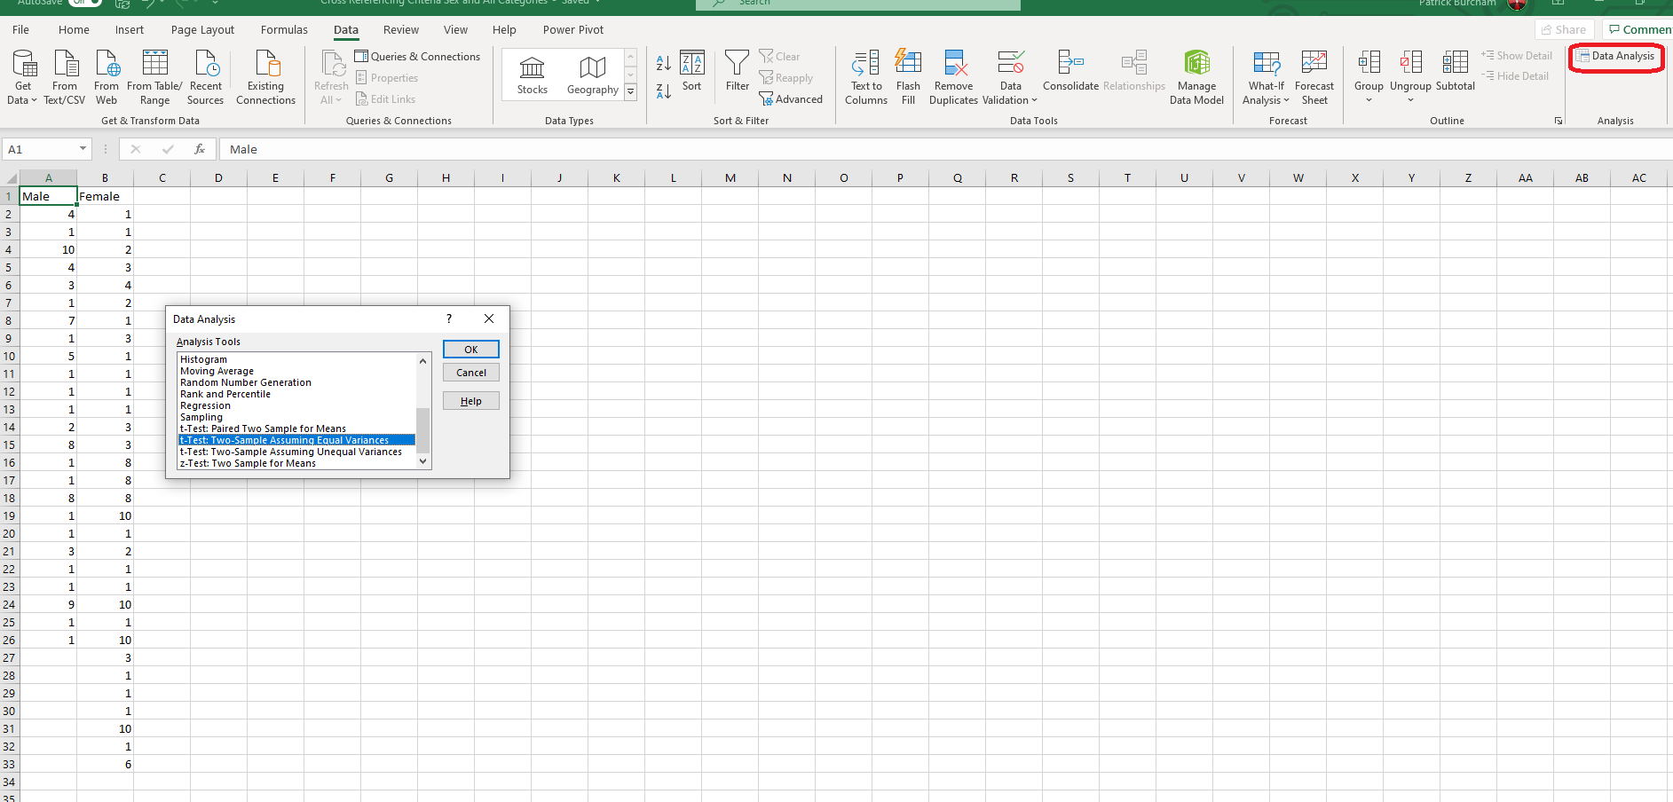
Selecting T-Test in Access

Slide 32
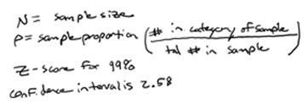
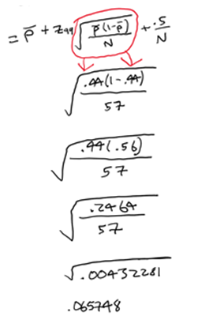
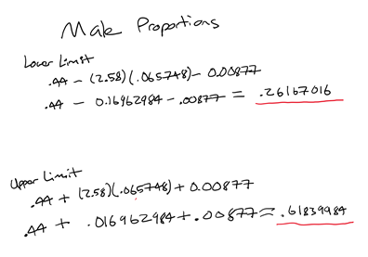
Calculating the Population Of Males at the school
Male Proportions

Slide 33
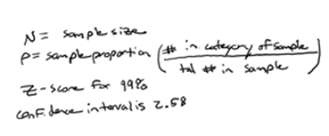
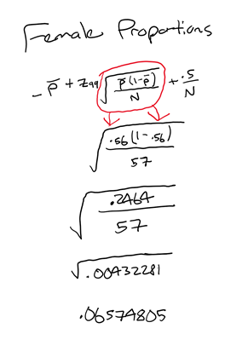
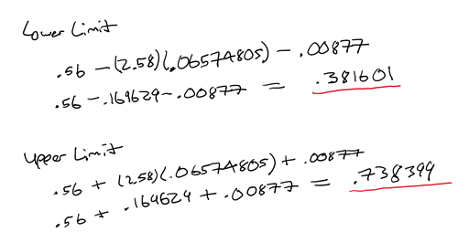
Calculating the Population Of Females at the school

Slide 34
Male and Female Preferred Notifications

Slide 35
Survey Questions
1. M/F?
2. What is your status at the College this semester?
3. Which web conferencing program do you prefer the most?
4. Roughly how often do you need to talk with your instructor(s)/Adviser outside of class?
5. In what way would you like to be notified about class/appointment sessions the most?
6. On a scale of 1 to 10 (1 being the least and 10 being the most) How difficult would it be for you to use web conferencing software to meet with your instructor?
7. Would you rather meet your instructor/adviser face to face on campus or online?
8. Do you agree or disagree that web conferencing is the future for students at Forsyth Tech?
9. What is your biggest concern about using web conferencing software for class and for one on one conferencing with your instructor?

Slide 36
Students who Preferred Face to Face Meetings and their College Status

Slide 37
Students who Preferred Online Meetings and their College Status

Slide 38
College Status and Average Perceived Difficulty

